Slide 1







TROY’s Mission
To exceed our customers’ expectations through excellence in four key areas...
Professionalism
Quality
Service
Innovation
For over 55 years, we’ve been helping top U.S. banks, government agencies, hospitals, and universities manage the risks of fraud while complying with government regulations. Our secure print solutions have enabled them to print anti-tamper:
Checks
Transcripts
Prescriptions
Sensitive Documents
IDs
Birth, Marriage, and Death Certificates

Slide 2









Who We Work With
As and industry leader, we work across every vertical and high-profile customers worldwide.
Fortune 500 Clients
400+ Worldwide
5 Billion Checks
140+ Countries
We serve 181 clients on the Fortune 500 list
We have partners, distributors and resellers globally
Are printed Globally with our MICR Toner
We’re a global leader
150+ Education
500+ Hospitals
130+ Government
9 Top U.S. Banks
Securing Transcripts
& Diplomas
Count on our Print Prescription Solutions
Agencies count on
our security
And banks in 70+
countries worldwide

Slide 3
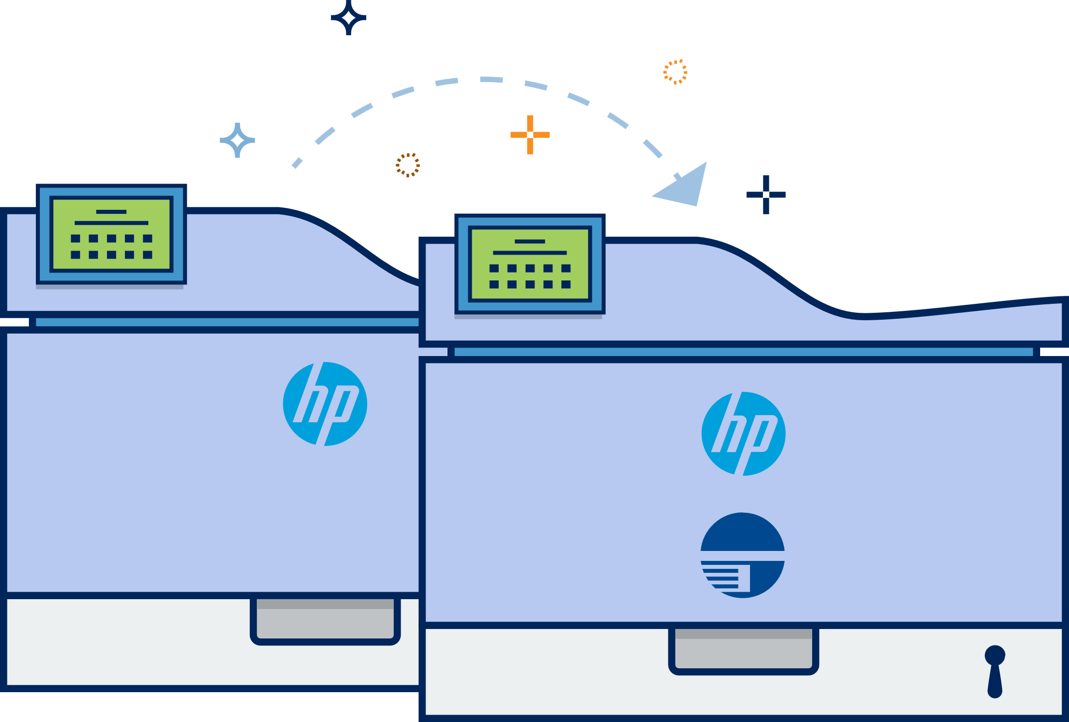

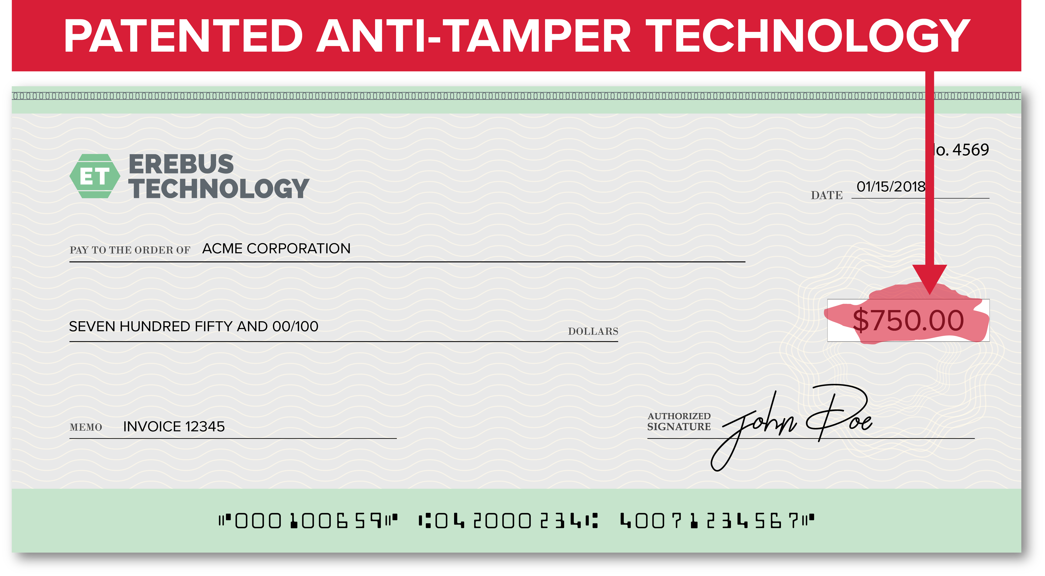
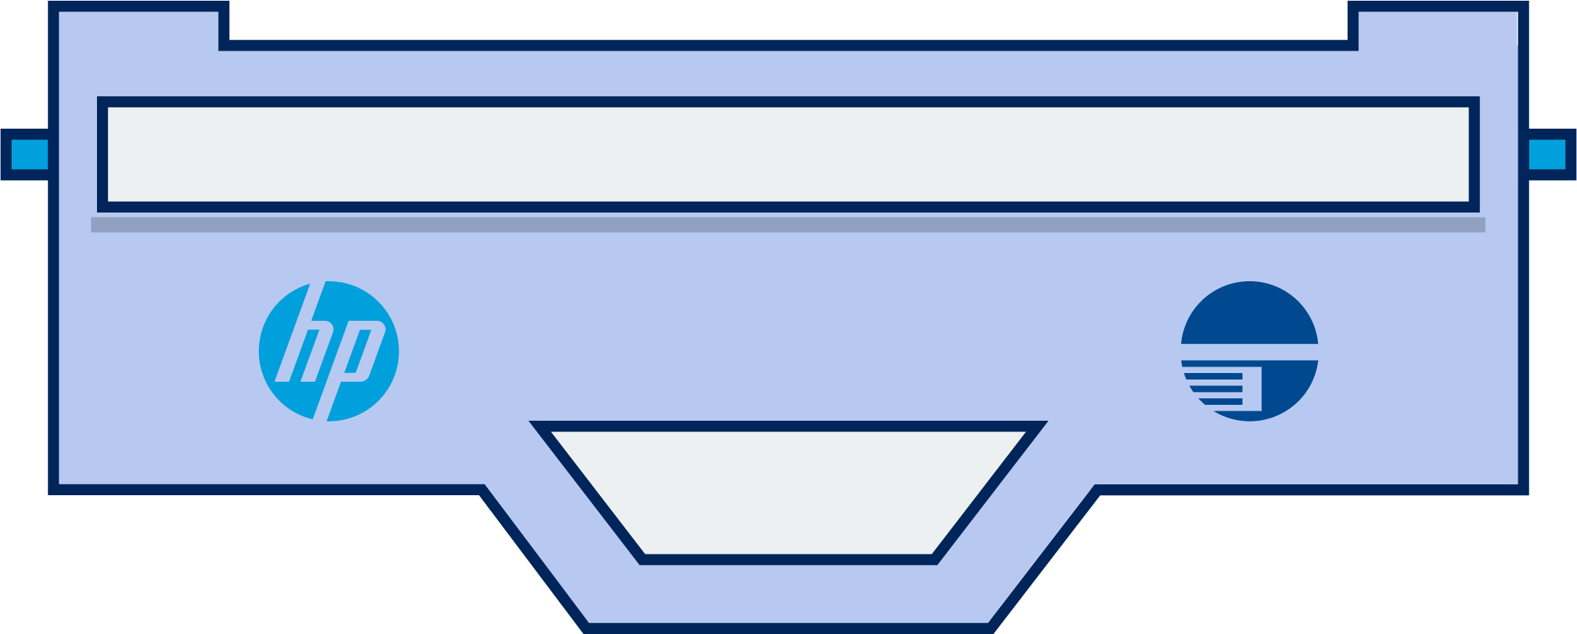

Total MICR Cheque Printing Solution
More than a font kit and MICR toner…
MICR Printers: Includes HP’s world class endpoint security, enhanced with 16+ security and functionality features.
MICR Toner Secure: Patented security technology releases a red dye if chemical alteration is attempted, voiding the cheque if fraud is attempted.
Cheque Printing Software: Range of software for SMB to enterprise, including specialized editions for banks, to meet the needs of your customers.
Exact Position Technology
Meets ANSI & ABA banking standards
Eliminate preprinted cheque stock
Toner Sensing
High-quality & reliable
Digitally sign cheques
Encryption & Decryption
High adhesion for maximum bank readability & toner will not easily scrape/wear off
Robust reporting
MICR Fonts

Slide 4

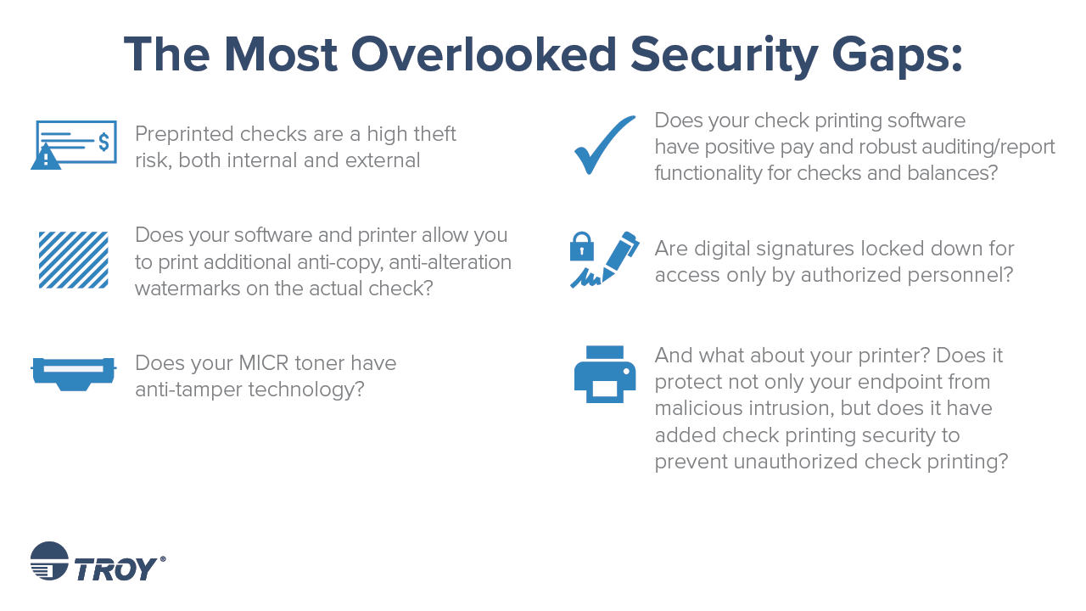
Notes:
So what are the next steps you can take to start securing your check printing process? These are some of the most overlooked security gaps.
Pre printed check- these are a high theft risk both internal and external
Outdated Software-Are you printing additional anti-copy, anti alteration watermarks on the check? Does your software have positive pay and auditing/reporting functionality?
Nonsecure Toner- Does your MICR toner have anti-tamper technology?
Nonsecure Signatures-Are your digital signatures locked down?
Outdated printer-Does it protect not only your endpoint from malicious intrusion, but does it have added check printing security to prevent unauthorized check printing? In 2016 HP released security firmware to prevent network intrusion. Any printer put into production prior to 2016 is opening our clients to hacker intrusion.

Slide 5
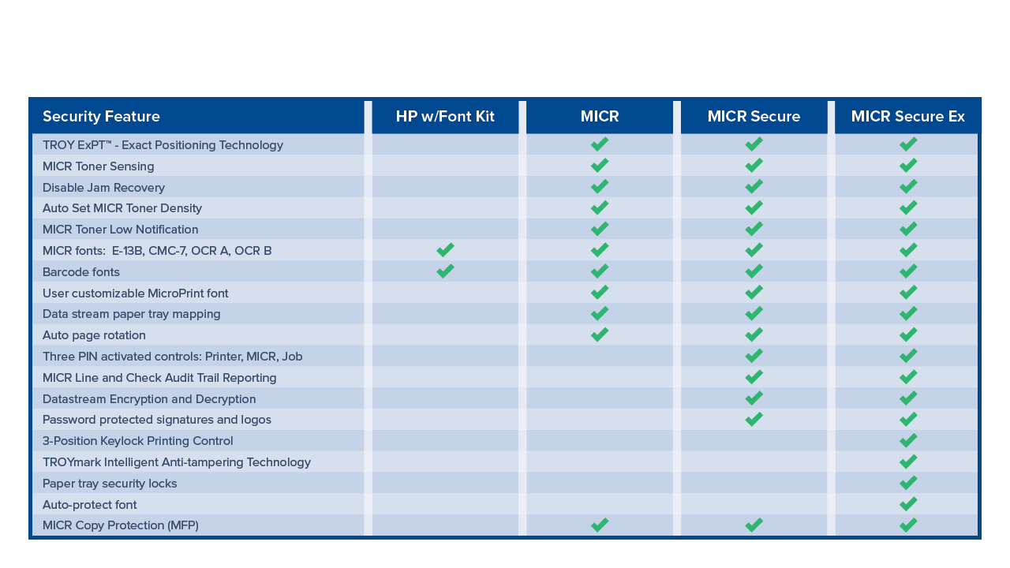
HP Printers with TROY Enhancements

Slide 6
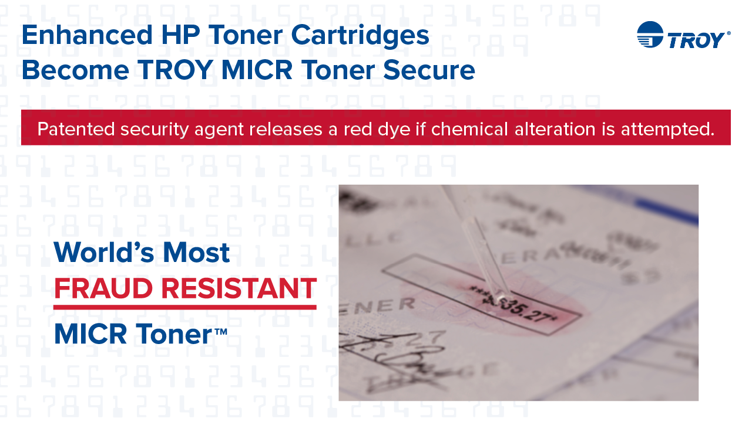
Notes:
Cost difference between competitor and remanufactured toners is our red security dye…more so than magnetized ink that passes industrial standards. The TROY red dye secures the entire document from chemical washing.

Slide 7




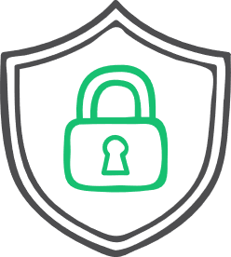


TROY MICR Issuance Workflow Assessment
Uncover security gaps and inefficiencies typically missed by an internal assessor.
Find the perfect solution for your clients
Recommendations to increase your retail ROI
Protocols that are wasting time and money
Task Automation to decrease internal fraud risks
Why your bank needs this assessment
Recommendations for increasing the security on printed financial instruments
Financial impact: savings & return on investment
Uncover security gaps within existing workflows
Increased internal and external security
Recommendations to improve workflow efficiency and decrease expenses
Improved processes for customer retention and quality service
Notes:
If all you are doing is talking about print, you are not differentiating yourself for you customer
Create value, trust, and awareness

